Slide 1
HOW TO USE
THIS SLIDE-
DECK
The slides contain relevant content for your own Co-Creating Our City project. They are provided for informational purposes, illustrating the five stages of the citizen science process, and may be used as a starting point for your own project.
Please adapt and add to these slides to suit your project by adding your own material, examples, and results from your Co-Creating Our City research. You should also consider rearranging slides as appropriate for the flow of your project.

Slide 2
INTRODUCTION
CO-CREATING
OUR CITY
Before getting started with the research, consider providing your co-researchers with an introduction to the project.
The following slides show the starting point for Co-Creating Our City and cover the basics of citizen science.
To adapt these to your own Co-Creating Our City project, consider adding an introduction to your team and a timeline of your project.

Slide 3
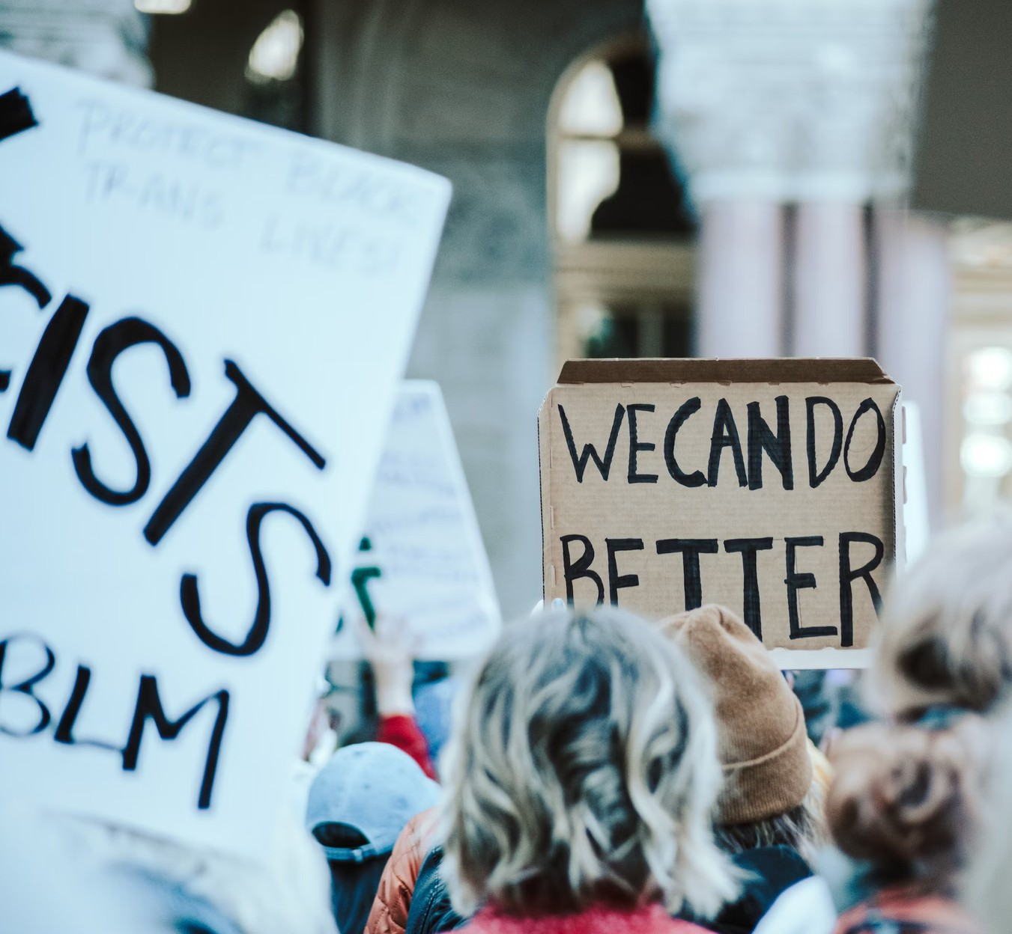
HOW TO ADDRESS THE
MISMATCH BETWEEN WHAT
YOUNG PEOPLE SEEK OUT AND
WHAT CITIES CAN OFFER?
Together, young people and city decision-makers generate insights into and concrete proposals for their cities to establish vibrant communities and solutions for next-level youth engagement.

Slide 4
Young People
A MISMATCH?
Cities
Often lack influence in government Are engaged on an issue-basis Seek out project-based opportunities
Use online platforms to express their ideas
Want to hear young people’s ideas for vibrant communities
Keen to engage, especially with underrepresented young people Sometimes lack efficient ways to engage with young residents

Slide 5
YOUR
This collaborative project uses a novel citizen science approach to address the mismatch between opportunities for exchange offered in cities and what young people seek out in terms of engagement to realize their ideas of flourishing communities.
The project sees groups of selected young people and city administrators investigate the needs and opportunities for youth engagement.
They make recommendations for tangible solutions to create vibrant communities in their own cities.
PROJECT

Slide 6
KNOWLEDGE
WHAT WE
WANT TO
Youth-led insights into the needs and opportunities
for youth engagement in cities
ACHIEVE
Ideas for vibrant communities that young people
and city decision-makers share
Feasible and actionable suggestions for future city-
wide youth engagement
COMPETENCIES
SOLUTIONS
Scientific and democratic literacy
City-specific and directly actionable proposals
for solutions young people and city
Increased civic engagement and political
administrators would like to see
efficacy
Blueprint for a future youth engagement
Identity and belonging to their cities among
process in the city
participating young people and city administrators

Slide 7
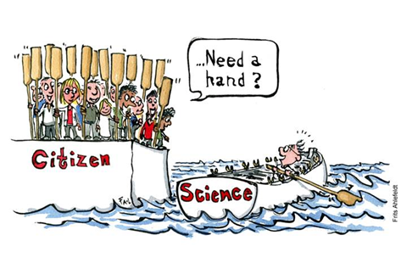
CITIZEN SCIENCE DESCRIBES
THE PARTICIPATION OF
PEOPLE WHO ARE NOT
PROFESSIONAL
RESEARCHERS IN
SCIENTIFIC RESEARCH.

Slide 8
Co-Created
CLASSIFICATION OF
PARTICIPATION IN
CITIZEN SCIENCE
Co-Creating Our City
Collaborative
The citizen scientists formulate research questions, report observations, carry out research and data collection, analyze data, and/or write publications.
Contributory
Bonney et al. 2009, Shirk et al. 2012

Slide 9
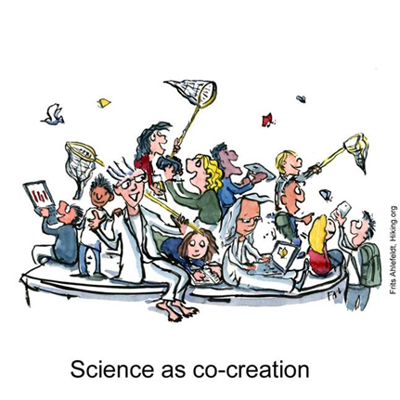
“CITIZEN SCIENCE AS A MEANS
FOR DEMOCRATIZATION OF
SCIENCE, PUBLIC ENGAGEMENT,
EQUITY, AND JUSTICE.”
IRWIN 1995
A key condition of citizen science is compliance with standards of rigorous research. This enables innovative research and new findings, and facilitates a dialogue between researchers and society that is very difficult to achieve otherwise.

Slide 10
THE SOCIAL
SCIENTIFIC
1. Articulating and specifying the
RESEARCH
research problem
PROCESS
2. Planning and preparing the
research
3. Data collection
4. Data analysis
5. Reporting findings

Slide 11
Collect ideas for the research topic
Literature review
1. Formulating Our
Research Question
Identification of research gaps
Articulation of research objectives and assumptions
Phase I

Slide 12
Choose research methods
2. Planning and
Preparing the Research
Design research instruments (e.g. questionnaires, interview guides)
Determine who to ask (sampling) Pretest or pilots of research methods
Phase II

Slide 13
Review data that may be already be available, e.g. policies, texts, secondary data
3. Data Collection
Conducting interviews, surveys, observations, etc.
Phase III

Slide 14
Process data to make it ready to be analyzed
4. Data Evaluation
Examine the evidence to understand meaning
Analyze data [or formal data analysis]
Phase IV

Slide 15
Compile topline findings
Publication Presentation of results
5. Reporting
Findings
Phase V
Closing Event

Slide 16
SOURCES ON
CITIZEN SCIENCE
https://
education.nationalgeographic.
org/resource/citizen-science-
article/
https://www.citizenscience.gov/#

Slide 17
RESEARCH QUESTION
CO-CREATING
OUR CITY
The following slides provide ideas for how to develop a research question.
Examples shown are taken from the pilot projects in Charlotte, NC and Düsseldorf, Germany. They illustrate how you could move from collecting ideas to a research question.
To adapt these to your own Co-Creating Our City project, replace the examples from our pilot cities with the work in your own project.

Slide 18
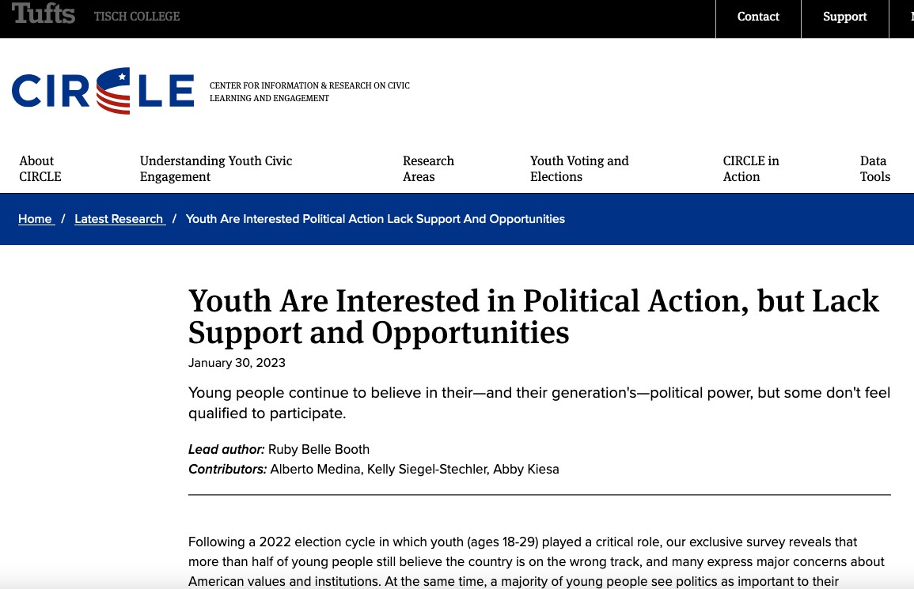
TUFTS UNIVERSITY YOUTH
ENGAGEMENT DATA
Present findings that are relevant for your own Co- Creating Our City project and provide an overview of the existing research. In Charlotte, NC, we looked at Tufts University Youth Engagement data.
https://circle.tufts.edu/latest-research/youth-are-interested-political-action-lack-support- and-opportunities

Slide 19
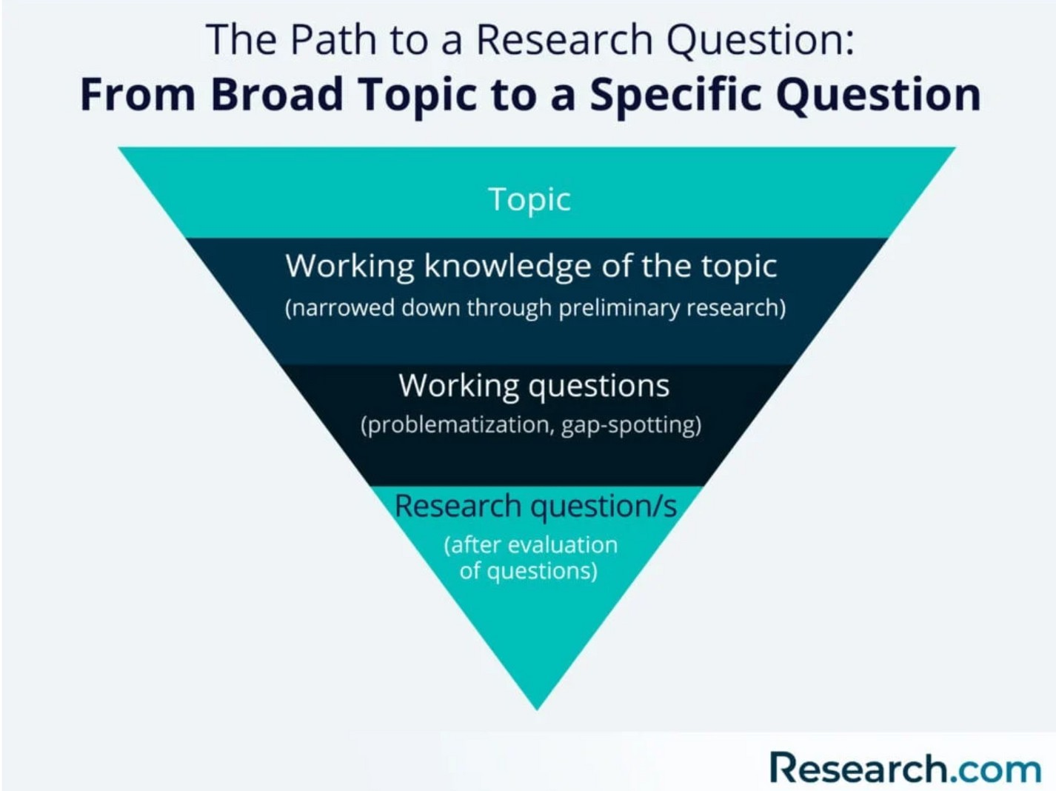
WRITING A
RESEARCH
QUESTION

Slide 20
RESEARCH
QUESTION
*Note that you are not arguing anything yet with the research question. It is just a format to make
the topic more specific and easier for you to research.
Example of an unclear research question: How does the environment affect people?
Example of a clear research question: How does prolonged exposure to air pollution in urban areas impact the respiratory health of adults aged 50 and above over a five-year period?
https://www.sjsu.edu/writingcenter/docs/handouts/Research%20Questions.pdf

Slide 21
RESEARCH QUESTION
CONTINUED
https://www.sjsu.edu/writingcenter/docs/handouts/Research%20Questions.pdf
01
02
Example Open-Ended Research Question: How does student use of Khan Academy in mathematics improve students’ understanding of mathematical concepts over time?
Example Non-Open-Ended Research Question: Is Khan Academy beneficial in improving
student test scores in mathematics?

Slide 22
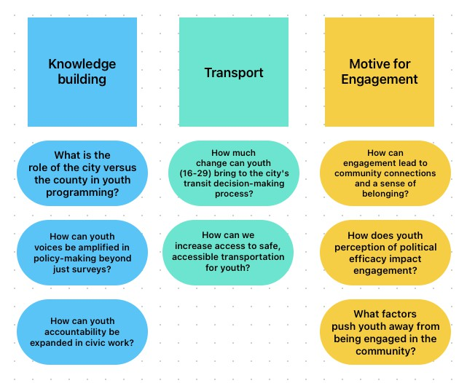
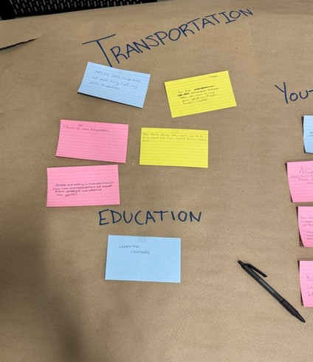
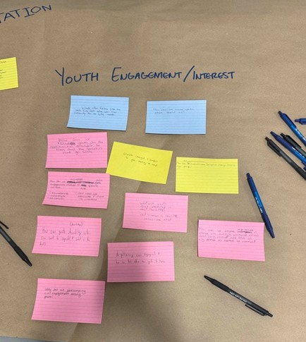
Example
RESEARCH QUESTION
Present the interim results of the group work from the workshop and, possibly, the online collaboration in between.
This summary will be the starting point for the specific formulation of the research question.

Slide 23
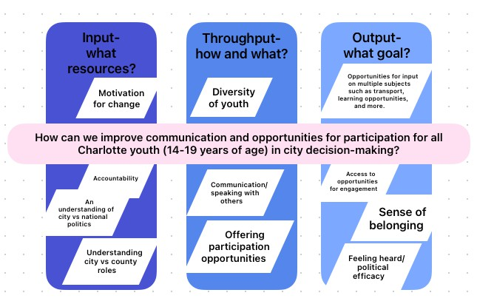
Example
RESEARCH QUESTION

Slide 24
PLANNING AND PREPARATION OF
THE RESEARCH
CO-CREATING
OUR CITY
The following slides provide ideas for how to design and select the research methods best suited to answering your project’s research question.
Examples shown are taken from the pilot project in Charlotte, NC. They illustrate how you could make decisions on your research methods.
To adapt these to your own Co-Creating Our City project, replace the examples from our pilot city with what suits your project.

Slide 25
Quantitative
QUANTITATIVE VS.
QUALITATIVE RESEARCH
Qualitative
Focus on collecting and analyzing numerical data to find patterns and test hypotheses.
Goal: explain, quantify, measure relationships Question: how many?
Hypotheses are tested Sample size >100 Sampling by system
Statistical methods for evaluating the data Results can be generalized and representative
Explore subjective experiences and meanings through non-numerical data exploration
Goal: understanding, exploring, deeper insight Questions: why? how?
Hypotheses are generated
Sample size: <100, often 5-20 or a single case Sampling based on characteristics
Various methods of evaluation possible Used to explore and understand complex concepts

Slide 26
Quantitative
METHODS
Qualitative
Text analysis methods: Frequencies or correlations
Observation: measurement of the frequency of customer contact
Eye-tracking: gaze behavior
Survey research: quantification through closed questions
Experiments: behavioral correlation
Interviews: closed questions
Data analysis: descriptive or inductive statistics
Text analysis methods: Interpretation of text content
Ethnography/field research: observation protocols
Image analysis: interpretation of image content Interviews: open, narrative, guideline-based Data analysis: interpretive (including qualitative content analysis)

Slide 27
WHAT IS A HYPOTHESIS?
HYPOTHESES
A hypothesis is an idea that is proposed as an argument to be tested to see if it might
be true.
Hypotheses are statements about relationships between characteristics
Hypotheses form a coherent argument
Hypotheses must be testable and falsifiable

Slide 28
EXAMPLES FOR HYPOTHESES
HYPOTHESES
If students eat breakfast, they will perform better on exams than students who do
not.
If social media usage among teenagers
increases, then their face-to-face social
interaction may decrease.
If flexible working hours are offered to
employees, then their reported job satisfaction
will increase.

Slide 29
DEVELOPING HYPOTHESES
HYPOTHESES
Hypotheses are tested against reality
Hypotheses are formulated based on what is known and assumed connections
Sources: Scientific literature & everyday
observations

Slide 30
SPLIT INTO
GROUPS TO
DISCUSS
A: Which qualitative methods could we
choose to answer our research question?
B: Which quantitative methods could we choose to answer our research question?

Slide 31
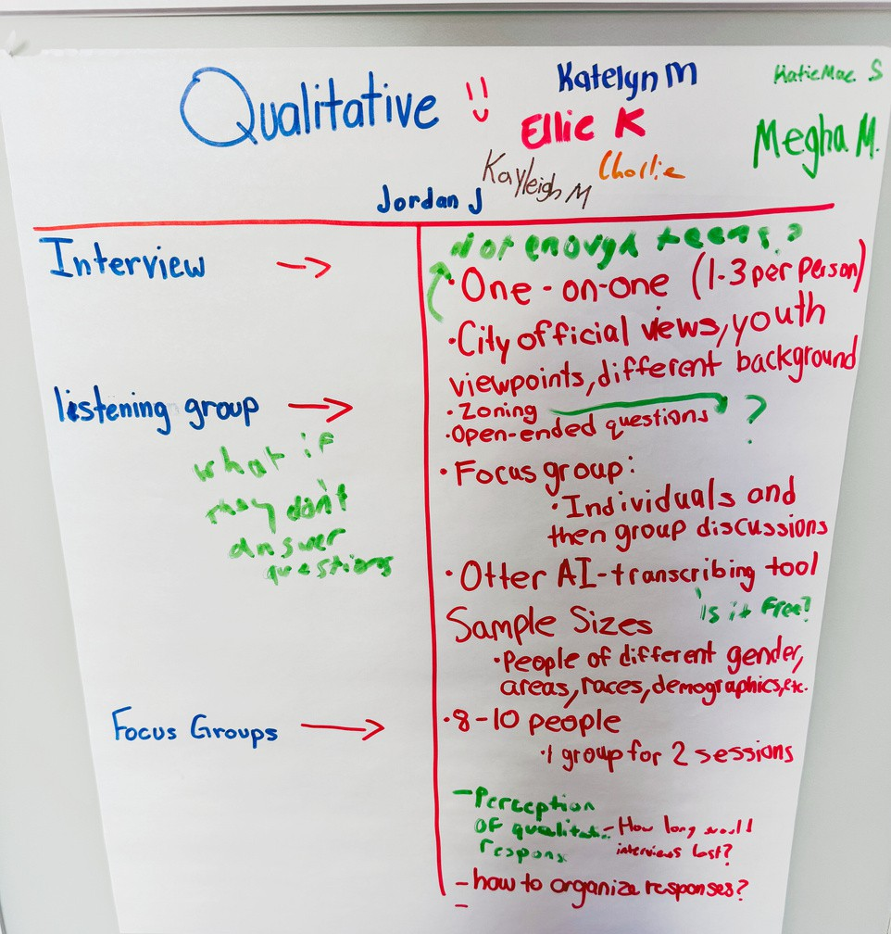
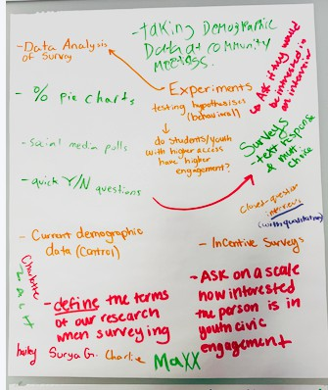
Example
Planning and Preparation
of the Research
Ideas for
Qualitative Research
Ideas for
Quantitative Research
Compile the ideas on research methods. As a group, decide on the methods for your own Co- Creating Our City project. It is also important to consider the feasibility of these methods within your resources.

Slide 32
Observation
METHODS
Present different methods that are suitable for your Co-Creating Our City project and from which the co-researchers can choose. These are examples from the Charlotte pilot project.
PROS AND CONS
One-on-One Interview
Survey
Few cases are necessary
Captures natural behavior in real-world settings.
Wide-ranging Generalizable results Anonymity
Less risk of social desirability
Opportunity for in-depth
analysis.
Outside perspectives bring new insights.
Opportunity to make
connections.
Time consuming Social desirability
Generalizability of the results Follow-up is complex
A combination of methods will
Lack of depth Lack of follow up
Higher number of cases required
be necessary Selective perception Confirmation bias Logistics

Slide 33
Listening
METHODS
PROS AND CONS
Behavioral
Social Media Polling
experiments
session/Focus Group
Potential for a high engagement
High control of outside factors.
Uncovering insights related to group dynamics.
Time for follow up questions and clarification.
Observation of nonverbal cues.
Real time/quick feedback about
an issue
Allows for standardized procedures, observation of impacts of certain variables.
Run the risk that sample is mostly
Need a plan for how to conduct the
friends/acquaintances
Lack of control of who participates
Time requires to gain
session, including dealing with
International Research Board
difficult circumstances.
approvals is limiting. Potential for artificial results
Potential group dynamic bias/social
Challenges with social media
desirability
Time consuming data analysis
platform distribution

Slide 34
MIXED-METHOD
Select methods for your own Co-Creating Our City project and then communicate how they will be applied. The following slides provide examples from the pilot project in Charlotte, NC.
DESIGN
In which areas do Charlotte youth want to contribute to city government and how can we increase access and engagement for youth (ages 14-24)?
Online Survey
1-1 Interviews
Focus Groups

Slide 35
DATA COLLECTION
CO-CREATING
OUR CITY
To prepare them for data collection, the co- researchers need to be trained in the research methods selected for your project.
The following slides show examples of how the methods used in the pilot project could be introduced. They also provide guidance on how to plan data collection with the group.
To adapt these to your own Co-Creating Our City project, use and add to slides on methods you are using and replace others with information on methods chosen in your own project.

Slide 36
INTERVIEW
What is an interview?
Group and individual
interviews
Sampling - selection process
Pilot testing

Slide 37
WHAT IS AN
INTERVIEW?
A form of asymmetrical
A data collection
communication
method
Reactive research method -- the
interacting individuals
Interviews are
data gathered in a standardized way
react to each other
Considered the “silver bullet” of qualitative research and frequently
used

Slide 38
INTERVIEW
NARRATIVE INTERVIEW (NOT STRUCTURED)
METHODS
SEMI STRUCTURED INTERVIEW
STRUCTURED INTERVIEW
EXPERT INTERVIEW
FOCUS GROUP LISTENING SESSION

Slide 39
SEMI STRUCTURED
INTERVIEWS
The semi structured interview is based on guidelines that are used with some flexibility
Order of questions can be variable Respondents can set priorities
The interviewer can follow up on what has been said to understand better
In analysis, guided interviews allow space for new discovery and theory building

Slide 40
SEMI STRUCTURED
INTERVIEWS
Setting is important
Questions and question order are important Create a pleasant atmosphere for conversation Explain how the interview will be conducted Focus on the respondent(s) and take a back seat Be curious but not knowledgeable
Ask questions, be ready to explain things No ambiguous or misleading questions
Do not ask alternative questions or multiple questions Simple choice of words
Set up and double check (and triple check) the recording device in advance
Take notes during the interview

Slide 41
LISTENING SESSIONS
A moderator of a listening session must be prepared to intervene in a number of cases:
Someone is dominating the conversation
People are not responding or responding inappropriately The conversation strays far off topic
The conversation remains superficial Some group members do not speak

Slide 42
FIELD TESTING/
PRETESTING
Goals
Train interviewers
Review and improve the interview guide Is the guide easy to use?
Is everything recorded?
Do we have catagories, that represent our interests and the research question?
Were important aspects overlooked?
Do a test run before the actual interview

Slide 43
OBSERVATION
Observation strategies
Challenges
Positives and negatives
Protocols
Pretesting

Slide 44
OBSERVATION
Observations are based on guidelines developed by researchers
Researchers directly observe and record behavior and environment
Observation is non-interventional
It is possible to gain qualitative and quantitative information through observation
Structured observation includes a predetermined checklist and questionnaire for the researcher

Slide 45
Going Native
CHALLENGES IN
OBSERVATIONS
Selective perception
The researcher unknowingly influences what is happening
Social desirability

Slide 46
OBSERVATION
POSITIVES
NEGATIVES
Can get information about what is already occurring
Selective perception
- Confirmation bias
- Self-fulfilling prophecy
May discover some unknown
information
Not a representative sample
Observation logs help with
negatives

Slide 47
Starting Point
OBSERVATION
Because no researcher is an objective observer -- it helps clarify what is being observed
What is an observation
PROTOCOL
protocol?
Dense description No interpretation
Depict sequences of actions Problem: Writing down non-verbal communication
Function
Structures the observation Reduces selective perception Generates standardized data Reduces risk of distortion due to memory errors

Slide 48
_{WHAT} SHOULD BE INCLUDED
IN A PROTOCOL?
Description of the field of investigation
Description of the physical space of the field of investigation
Description of interactions within the field
Description of one's participation in interactions in the field
Reflection on the research process
Self reflection

Slide 49
PRETEST/FIELD TEST
Goal
Train observers
Review and improve observation protocol Is the protocol sheet easy to use?
Is everything recorded? Are the categories clear?
Were important aspects overlooked?
Do a test run before the observation

Slide 50
SURVEY,
QUESTIONNAIRE
Question design
OR SOCIAL
MEDIA POLLING
Questionnaire development
Tips for creating a questionnaire
Selection of interviewees
Pretest

Slide 51
Simple introductory question introducing the topic Middle:
QUESTIONNAIRE
STRUCTURE
Salutation text Who are we?
What do we want?
Guarantee anonymity and informed consent
Scientific purposes and rigour
Process and assistance in completing the survey
Develop a narrative (central questions in the second quarter; common thread; sort question blocks thematically)
Varied question types (multiple and single answers; open and closed; individual answers and scales)
Sociodemographic data at the end (age, gender). Conclusion: Thank you for participation

Slide 52
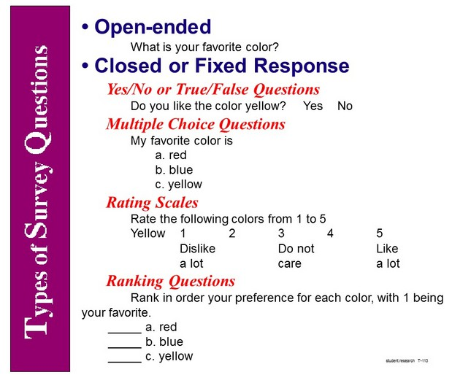
SURVEY CREATION TIPS
Questionnaire design Must hold your interest Be subject-related
Topics must be of personal concern
Be technically simple to complete
Ask as many as necessary
Question formulation Formulate simply, not ambiguously
Neither long nor complex Choose questions with a clear time reference
Answering options must be unique and mutually exclusive Avoid jargon or define unclear terms
https://researchbasics.education.uconn.edu/types- of-survey-questions/

Slide 53
PRETEST/FIELD TEST
Goal
Test the questionnaire before it is used: Is the questionnaire easy to answer? Is everything recorded?
Are the questions understandable? Were important aspects overlooked?
Do a test run before the actual survey

Slide 54
1. Gather themes
GROUP WORK -
BRAINSTROMING
3. Building a survey instrument
What topics do you want to conduct the survey on?
What are you interested in?
Collect questions for the interviews.
Collect goals for observation.
Collect questions for the questionnaire.
2. Objects of investigation
4. Going into the field
Who do you want to study/ask questions?
What do you want to observe?
How do you find/contact the people to be studied? How do you come up with the participation formats? Where can you have the questionnaire filled out?
5. Presentation of ideas
All groups present.

Slide 55
1. Which work steps are involved?
PLANNING
DATA COLLECTION
These questions provide the basis for defining individual work steps and responsibilities within the group, as well as creating a schedule for data collection.
What information do we need for this?
What preparations do we need to make?
Which people need to be involved?
How long do we need for the individual work steps?

Slide 56
Example
RESEARCH TIMETABLE
January 2025
February 2025
March 2025
April 2025
May 2025
Preparation
interview guide
accsess to the field
survey concept
Realisation
Interviews
Survey
focus groups

Slide 57
DATA EVALUATION
CO-CREATING
OUR CITY
The following slides provide ideas for how you could work through the data analysis with your co- researchers.
Examples show the analysis of semi-structured guided interviews and are taken from the pilot project in Düsseldorf, Germany. They illustrate how you could work together to analyse your data.
To adapt these to your own Co-Creating Our City project, consider giving a general introduction to data analysis and replace examples from our pilot city with material from your own Co-Creating Our City project.

Slide 58
DATA ANALYSIS
Method
Descriptive Statistics Inferential Statistics Content Analysis Grounded Theory
Case Study
Ethnography
Mixed-Methods
Type
Quantitative Quantitative Qualitative Qualitative
Qualitative
Qualitative
Mixed
Purpose
Summarize and describe features of a dataset
Generalize findings, test hypotheses
Categorize and interpret textual or visual data
Inductively develop theory from data
In-depth analysis of a single unit (person, group, event)
Study cultures/communities in their natural context
Combine qualitative and quantitative for comprehensive view
Typical Use Case
Reporting demographics, summarizing survey responses
Comparing group outcomes, assessing intervention impacts
Analyzing interview transcripts or open-ended survey responses
Developing new theoretical frameworks from fieldwork
Understanding specific organizations, phenomena, or communities
Observing daily practices in a community
Integrating surveys with interviews/focus groups

Slide 59
Transcribe
ANALYSIS PROCESS:
QUALITATIVE
CONTENT ANALYSIS
Read and discover
Build categories and code
Summarize and analyze
Interpret and reflect

Slide 60
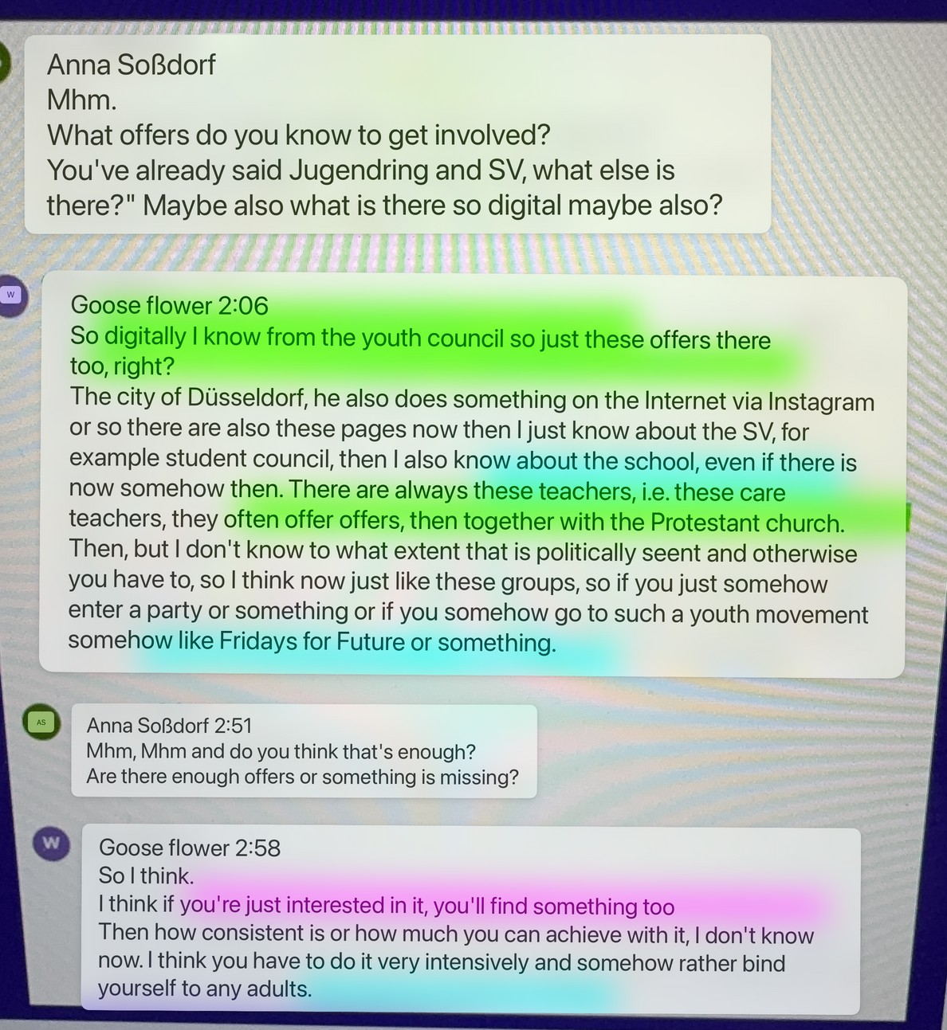
Example
READ AND
DISCOVER
Engagement offers
Motivation/ Obstacles
Opportunity/ Network

Slide 61
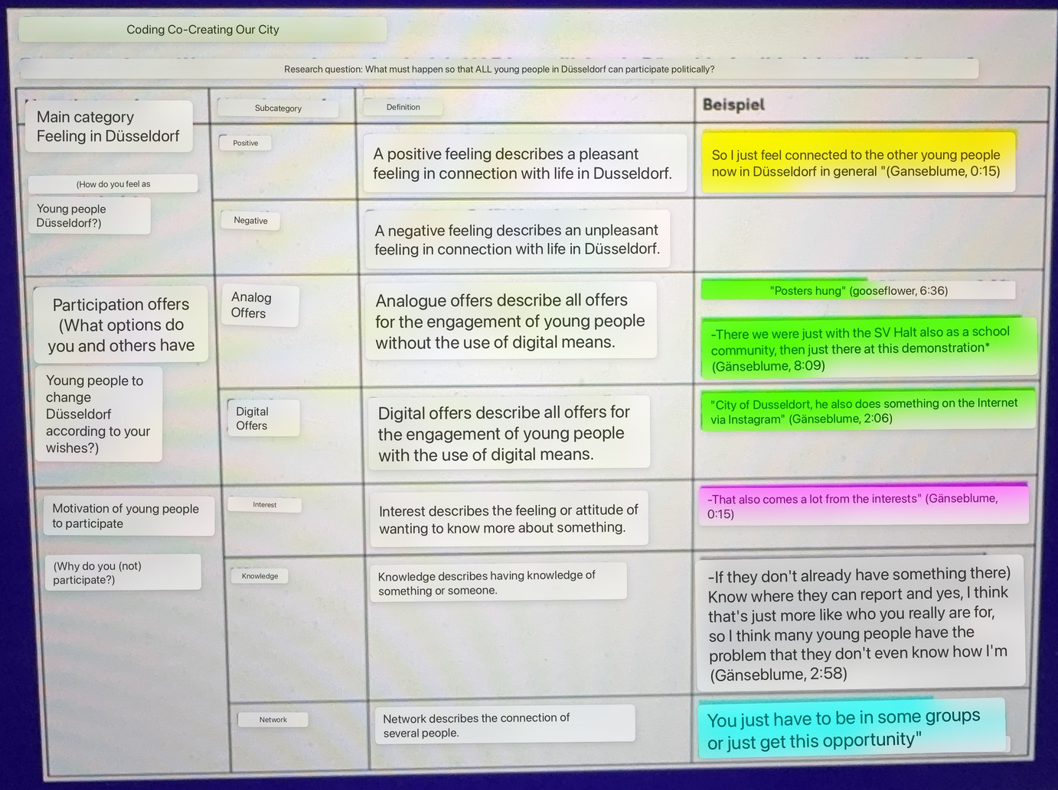
BUILDING CATEGORIES
AND CODING THEM
Feeling in Düsseldorf
Engagement- offers
Motivation/ Barriers
Knowledge
Opportunity/ Network

Slide 62
DISSEMINATION
CO-CREATING
OUR CITY
The following slides provide an introduction to useful approaches from science communication to communicate your project’s findings.
To adapt these to your own Co-Creating Our City project, consider adding examples that are relevant to your co-researchers and that can serve as inspiration for communicating your own Co-Creating Our City project.

Slide 63
To inform and inspire the public about
WHAT IS SCIENCE
COMMUNICATION?
External science communication: researchers and the public enter
scientific research
into dialogue
Communication departments of research institutions (e.g. university press offices) Researchers via the media (e.g. newspaper, TV or radio interviews)
Events (open days, science nights, interactive exhibits)
Directly via social media and blogs
Internal science communication:
within scientific field(s)
Researchers exchange ideas with each other Focus: conferences and academic publications

Slide 64
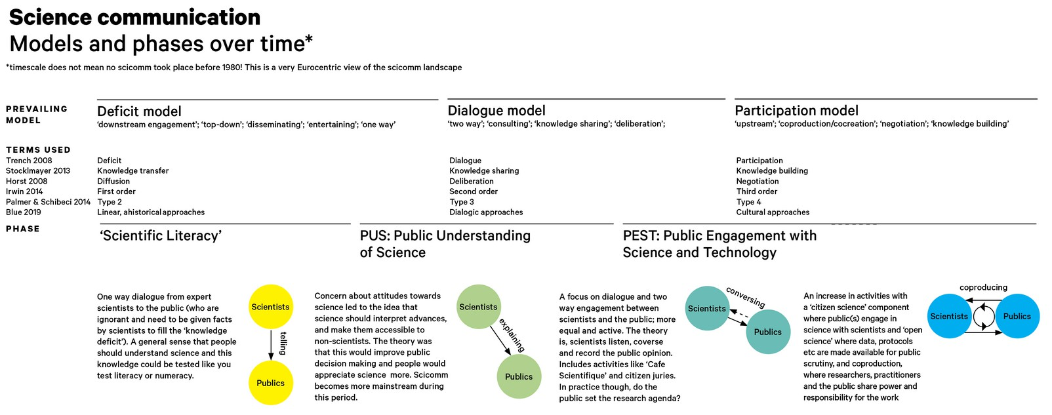
DEVELOPMENT OF
_{S}CIENCE COMMUNICATION
https://makinggood.design/thoughts/phd-part-08-what-is-science-communication/

Slide 65
Central element of a democratic society Can enable citizens to reflect on scientific facts and make informed decisions Enables participation in the knowledge of society
Important to counter for dis- and misinformation
WHAT IS THE PURPOSE
OF EXTERNAL SCIENCE
COMMUNICATION?

Slide 66
Arguments
WHY EXTERNAL
SCIENCE
The public gets an insight into
COMMUNICATION?
topics of scientific research
current and relevant debates in research the use of methods
results and findings
Not a one-way street
Not just providing information Dialogue with the public
Requirement or justification
Much research is funded by the public / tax Researchers must be accountable to the public for their research

Slide 67
Arguments
WHY EXTERNAL
SCIENCE
Finding the next generation of
COMMUNICATION?
researchers
Stimulates enthusiasm for research
Can motivates people to pursue research careers
Citizen science: Citizens as a way to
enrich insights from research
Citizens think outside of disciplinary standards
Their perspectives can inspire researchers to
think and research ‘outside the box’

Slide 68
Know the target group
CONDITIONS FOR
Who do I address and how?
Which medium do I choose for my target group? (e.g. social media, podcast, blog ...)
Balance between complexity reduction
SUCCESSFUL
EXTERNAL SCIENCE
COMMUNICATION
and simplification
Content must be understandable for non- experts
Reduction of complexity not at the expense of
correctness of content
Create enthusiasm and spread passion
If you are passionate about a topic, you can inspire others!
Why is the topic important?
What is exciting about it for the target group?

Slide 69
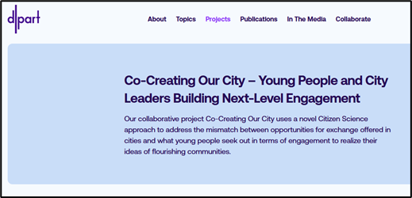
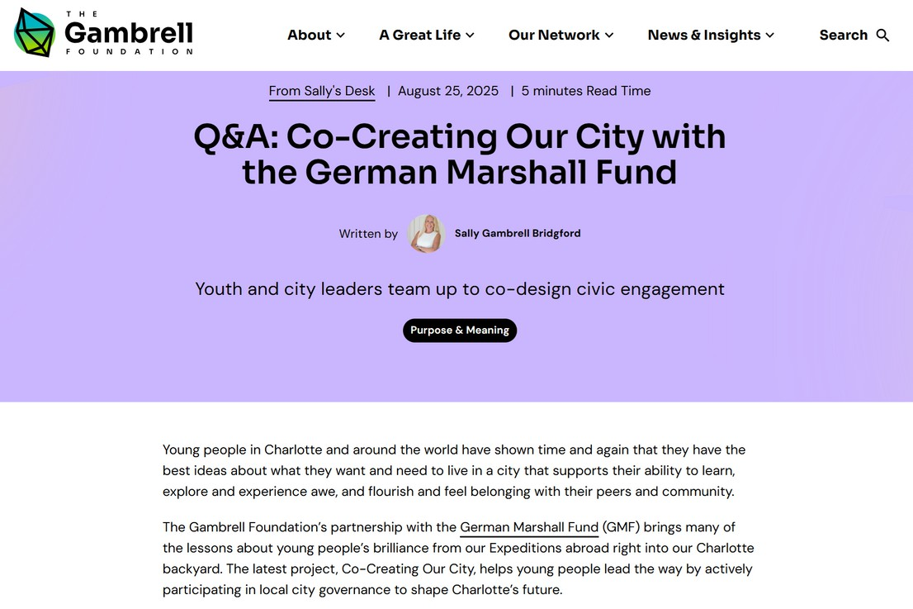
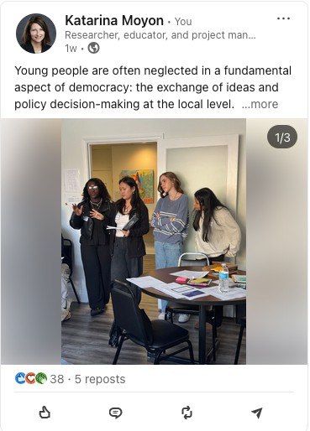
EXAMPLES OF SCIENCE
COMMUNICATION

